Slide 1
Verification of Stability Theorem for Tame functions
Final Project (Computational Topology)
Lakshmikar Polamreddy
12/30/2024

Slide 2
Introduction
The Stability Theorem ensures the robustness of persistence diagrams under perturbations of tame functions.
Persistence diagrams are key tools in topological data analysis, summarizing the topological features of functions.
This work verifies the theorem for some random tame functions using bottleneck distances.

Slide 3

Bottleneck distance
The bottleneck distance is a metric used to compare two persistence diagrams X and Y, which are sets of points in R2
Distance between Points : For two points x=(x1​,x2​) and y=(y1,y2), the distance is measured as:
Bijections Between Diagrams: Consider all possible bijections η: X→Y between the points of the two diagrams.
Bottleneck Distance Formula: The bottleneck distance is the infimum of the supremum distances over all bijections:
Notes:
A bijection is a function that creates a one-to-one correspondence between two sets.
Among all these bijections, the infimum selects the bijection that minimizes the supremum of distances between matched points.

Slide 4
Tame functions
Let f:X→R, where X is a topological space and f is a tame function if it satisfies the following properties. Finite Homological Critical Values:
f has only a finite number of critical values where the topology of the sublevel sets Xa=f−1((−∞,a]) changes.
These critical values correspond to events such as the birth or death of topological features like connected components, holes, or voids in the sublevel sets.
Finite-Rank Homology Groups:
For each sublevel set Xa, the homology groups Hp(Xa) (where p is the homological dimension) have finite rank.
This means the number of p-dimensional topological features, such as 0-dimensional connected components or 1-dimensional loops, is finite.

Slide 5
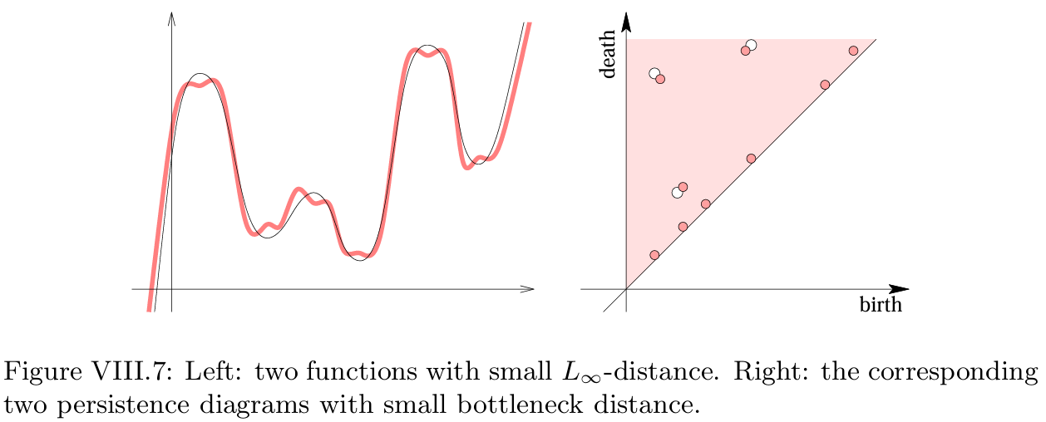

Stability Theorem for Tame functions
Let X be a triangulable topological space
f,g : X → R two tame functions.
For each dimension p, the bottleneck distance between X = Dgmp(f) and Y = Dgmp(g) is bounded by the L∞-distance between the functions
Example from the textbook [3]

Slide 6
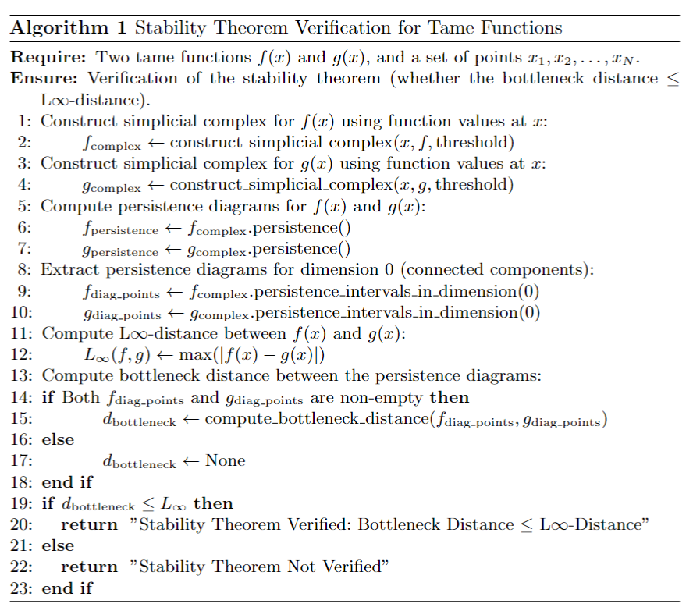

Methodology
Define tame function f(x) and perturbations g(x).
Construct simplicial complexes
Construct persistence diagrams for f and g.
Extract points corresponding to dimension 0 (H0)
Compute:
L∞​-distance between f and g -
Bottleneck distance between their persistence diagrams.
Verify Bottleneck Distance≤L∞-Distance.

Slide 7
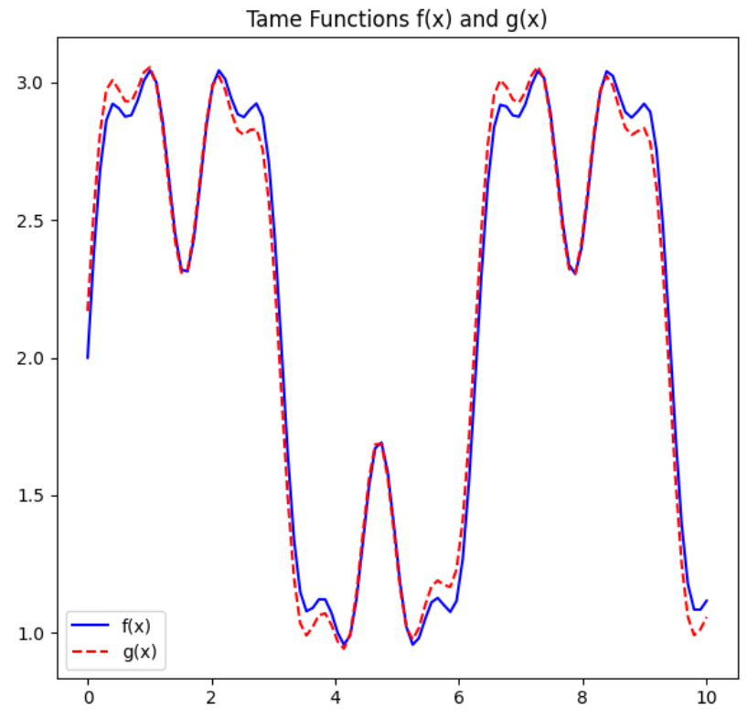
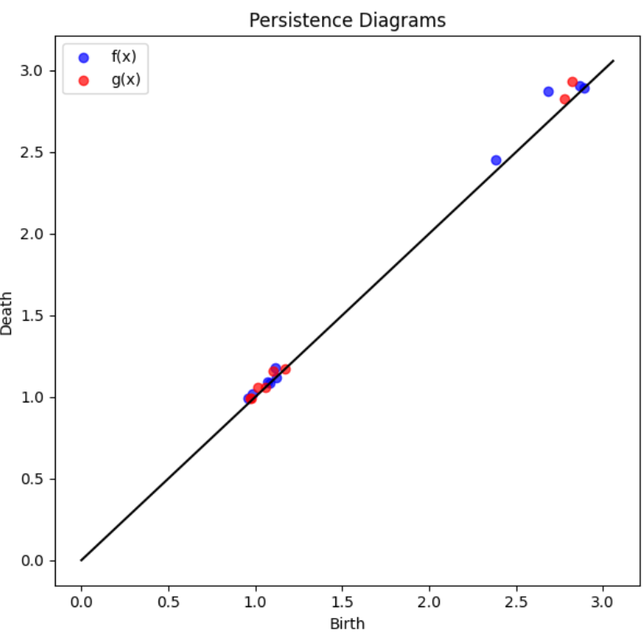
Experiments and Results
Define a tame funcion f(x) and its perturbation as follows
Persistent diagrams (H0)
Key Observations:
L∞​-distance between f and g: 0.1698
Bottleneck distance between persistent diagrams of f and g: 0.0981
Verified: Bottleneck Distance ≤ L∞-Distance

Slide 8
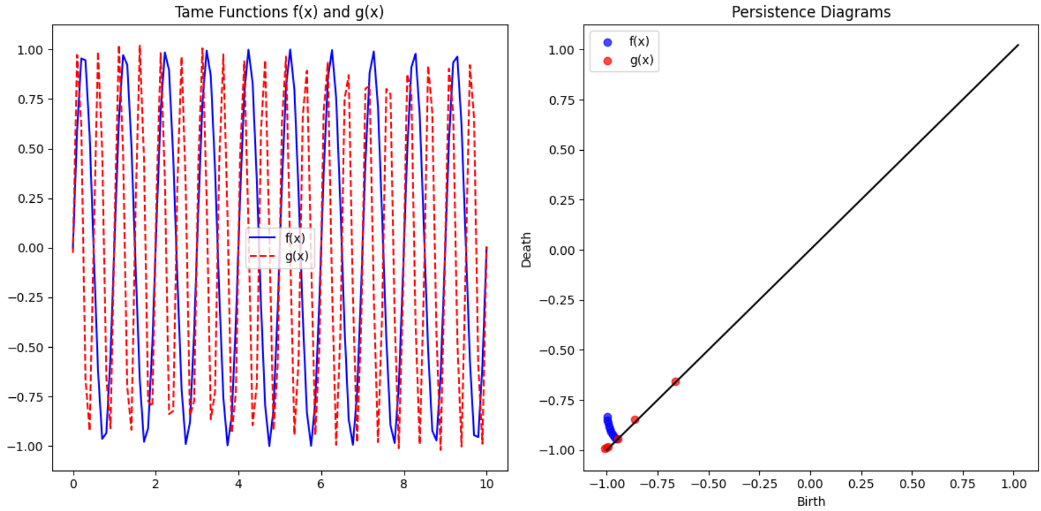
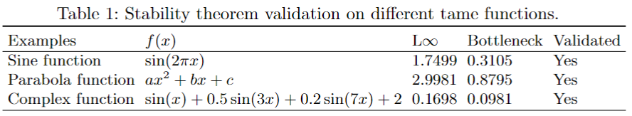
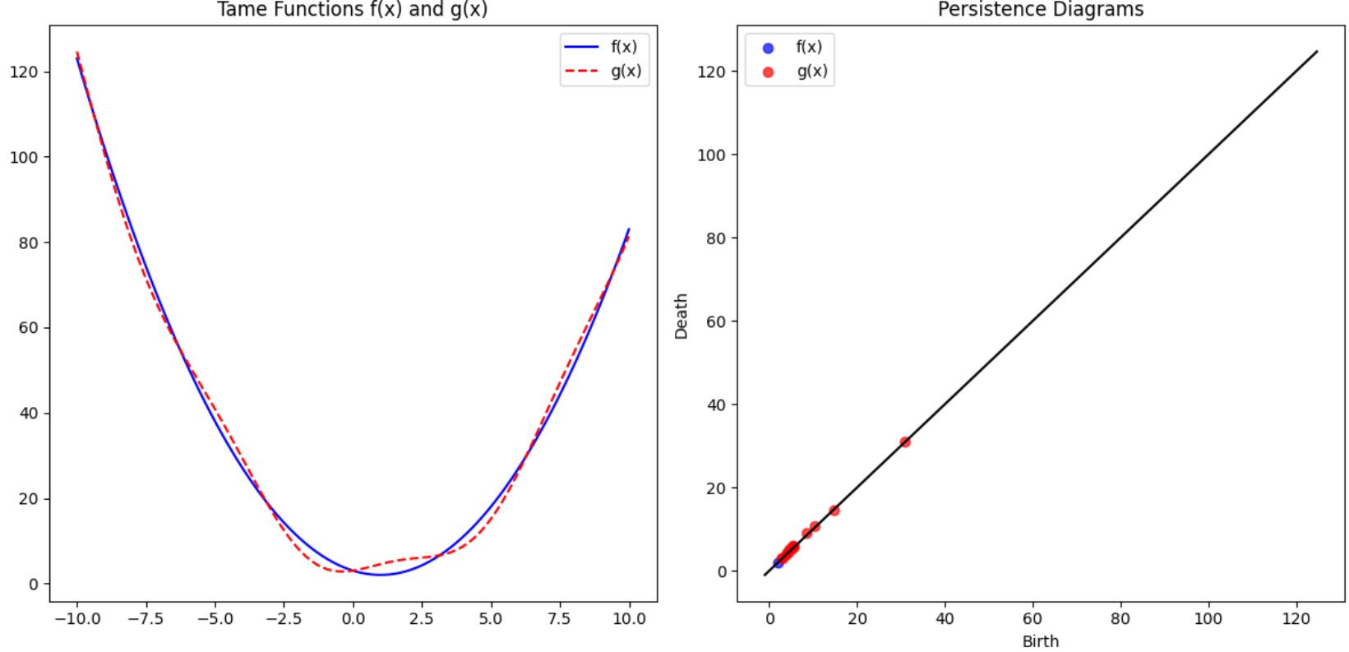
Experiments and Results
Ablation Study:
Experiments conducted on different tame functions as shown below
Sine function
Parabola function

Slide 9
Conclusion
Conclusion:
The Stability Theorem is verified for the tested functions.
Persistent homology provides a reliable measure of topological robustness.
Future Work:
Explore higher-dimensional homology.
Explore Wassetain Stability.
Test with more complex tame functions.

Slide 10
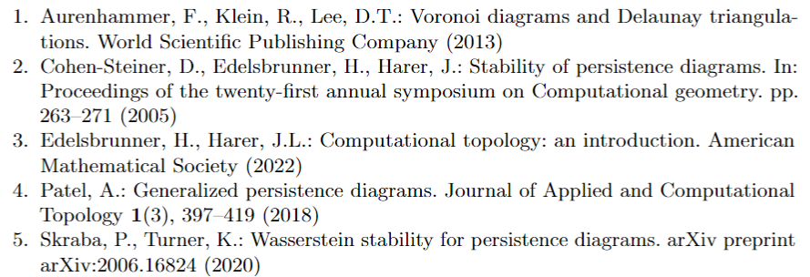
References

